Slide 1
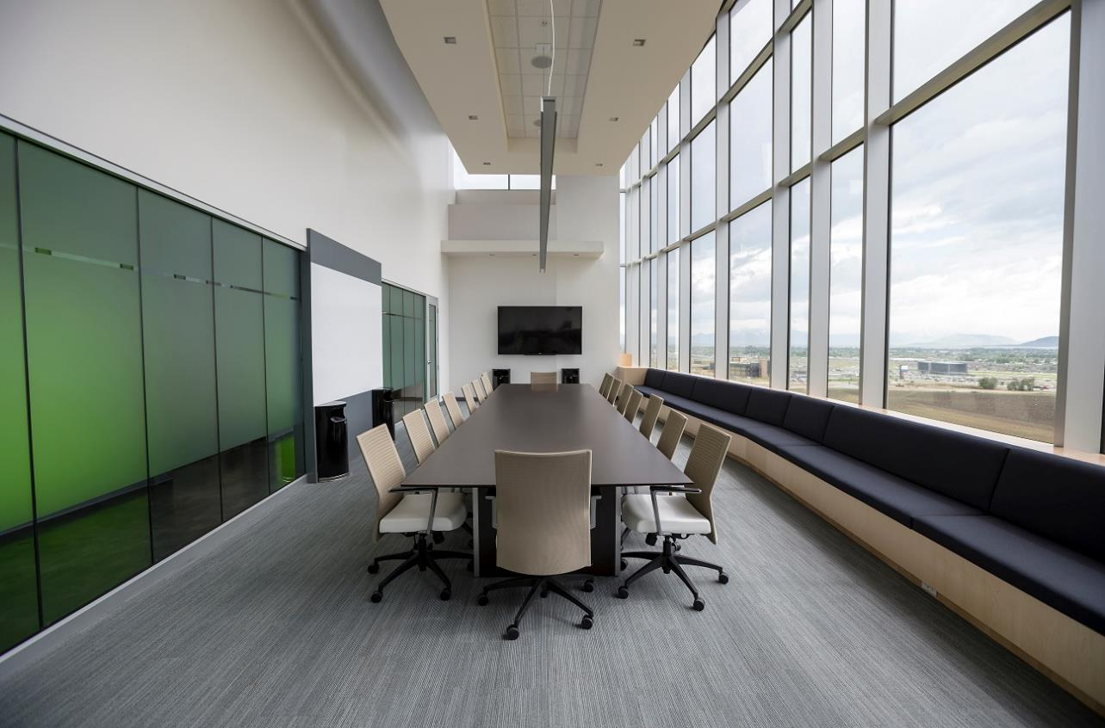

aAtom ERP

Slide 2

aAtom ERP Solution
01
01
For Large Enterprises Complete set of business functionality for all its requirements.
Large Enterprises
02
aAtom ERP is customized as per needs of mid size companies. Software is easy to install, implement and maintain. It also provides full range of business functionality
03
This can be implemented in matter of days and contains all the business functionalities.
03
02
Small Companies
Midsize companies
01

Slide 3
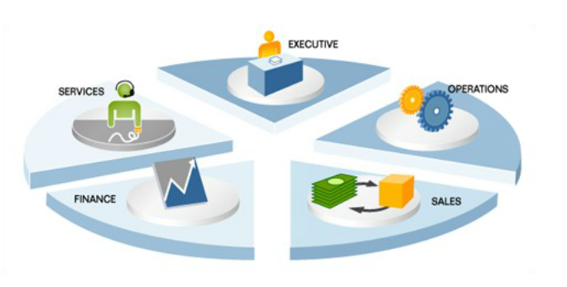
Legacy System
Legacy system used to store informations in individual silos.
Maintaining these multiple systems is costly.
Consumes more time for data retrieval for analysis and to run business.
02

Slide 4
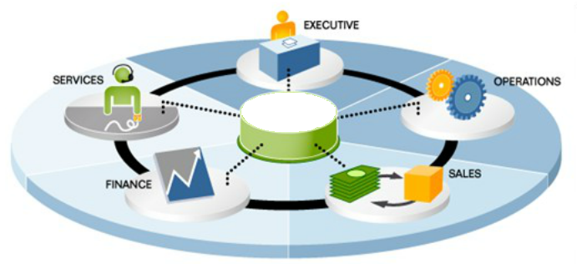
aAtom integrated ERP System
aAtom integrated ERP system allows you to stay on top of your business and provides a true and unified picture of critical, real time business information across your organization with embedded CRM, Finance and Manufacturing
aAtom
Get actionable alerts when service quality in the organisation drops.
Reduces back orders or over stock by planning purchasing according to real customer demands.
03

Slide 5





Benefits of aAtom ERP on Cloud System
Easily Upgraded
Productivity
Anywhere
Benefit of
aAtom
Cloud
Off site
Data Storage
Lower cost of
Ownership
No IT
Maintenance
Cost
Always Up
Disaster
Assistance
04

Slide 6








aAtom ERP Modules
Supply
Chain
Management
Purchase
Production
After Sales Service
Customer
Relationship
Management
Finance
and
Accounts
Inventory
Quality
.
05

Slide 7
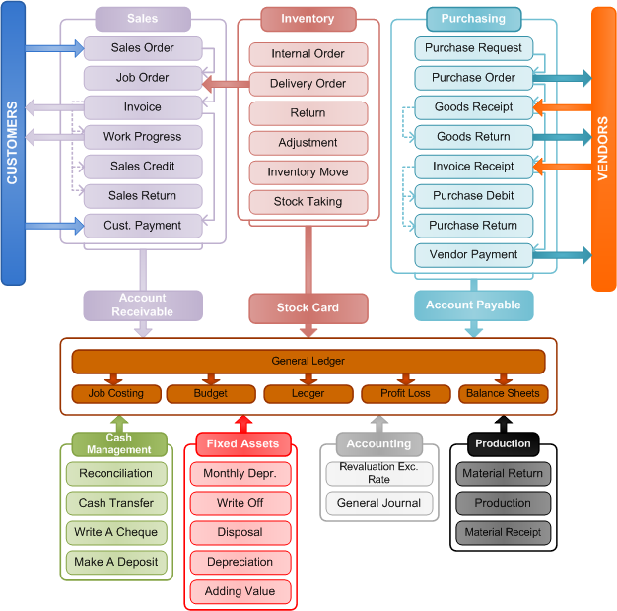
aAtom ERP Modules
.
07

Slide 8
aAtom Implementation Process
STEP 1
STEP 3
STEP 5
PROJECT PREPERATION
Define Goals & Objectives.
Clarify scope.
Strategy ,Schedule & resources
.
REALISATION
Solution Configuration
System Implementation testing.
Release it for Production.
GO LIVE & SUPPORT
Per production to live.
Production.
Support.
STEP 2
STEP 4
BUSINESS BLUEPRINTS
Requirement Workshops
Document Business Process
Define Baseline scope
Refine Overall scope.
FINAL PREPARATION
User Acceptance Test.
End User Training.
System management.
Cut over Activities
08

Slide 9
Thank your for your valuable time

